Slide 1
Derived Study Elements
Building an Analytic Dataset in N3C
N3C LOGIC LIAISONS:
Johanna Loomba, ME
Andrea Zhou, ME

Slide 2
Learning Objectives
What does it mean to build an analytic dataset for observational research?
What are important considerations I should take into account?
What are some available N3C tools that can help me?

Slide 3
Background

Slide 4
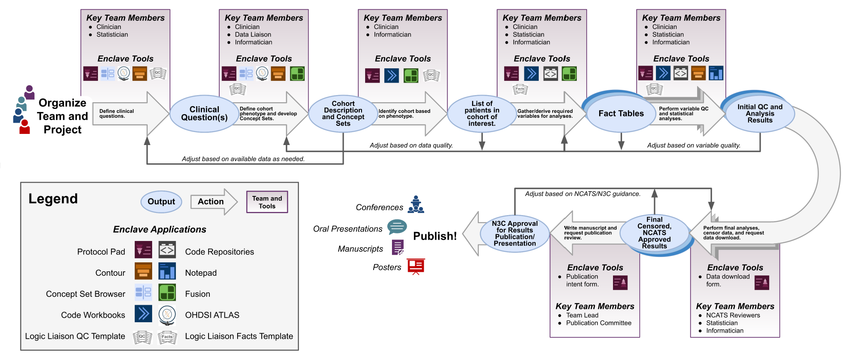
Observational Research: An N3C Study Workflow Perspective
Image Source: The Researchers Guide to N3C https://national-covid-cohort-collaborative.github.io/guide-to-n3c-v1/chapters/tools.html
Notes:
This is one representation of the iterative processes that make up a project workflow in N3C. Today Andrea and I are going to share some tools that we call Logic Liaison templates which are fundamentally data pipelines that embody much of the work that analysts must perform as they support this research process. You will notice that our templates can support each stage represented in the top row of this diagram, all of which need to be done efficiently and with great care before you get to the analyze and publish steps!

Slide 5
Observational Research: Foundations Matter!
Contribute to Scientific Knowledge and Improve Health
Cohort and Variables: Conceptual Definitions
Derived Data Quality Assessments
Publish
Design Translational Research Question
Cohort and Variables: Data Pipelines
Download Aggregate Results
Organize Team
Assess Feasibility
Perform Analysis
Know Your Data and Its Limitations
Notes:
Before talking about any specifics related to deriving data elements, lets look at each of the steps in that same workflow in light of what I believe is the essential foundation of good observational health research: Knowing your data and its limitations.
Organize your team: as a team, can you collectively understand the data and its limitations? Do you need patient advocates? More informaticians? Biostats and clinical knowledge may not be enough.
Design Research Question: Can your data be used to answer this question? Does it cover your basic assumptions related to WHO and WHAT is captures?
Cohort and Variables: Conceptual definitions. How will you select the relevant patients and facts? What parameters need to be applied to ensure reasonableness? Are there temporal considerations?
Assess Feasibility: Before you start coding, go back to the raw data elements and explore more in light of the definitions.
Data Pipeline and Quality Assessments: We will spend more time talking about these steps in the following slides, but they are clearly tied to data limitations
Perform Analysis: Do the results make sense? Can you perform some sensitivity analyses, apply some different analytic approaches, or do different train and test folds to ensure findings are stable? How do you think data limitations might be impacting your results?
Download Aggregate Results: Only do this once you are confident you can explain the results you have! Make sure to go through appropriate approval.
Publish: Remember to disclose all limitations and use language that is consistent with the data that backs up your variables and findings. Reviewers will notice!
If strong, your foundation is likely to support many projects!

Slide 6
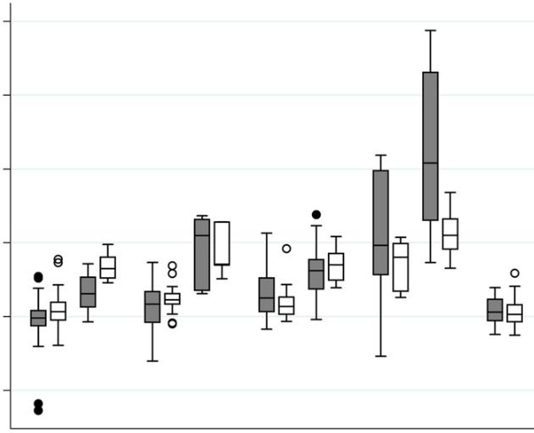
Harmonized Clinical Records to Analytic Results
person
 | v1 | v2 | … | vX
Patient 1 | 0 | 0 | … | 1
Patient 2 | 0 | 1 | … | 0
… | … | … | … | …
Patient n - 1 | 0 | 1 | … | 0
Patient n | 1 | 0 | … | 1
drug_exposure
condition_occurrence
measurement
device_exposure
1
2
procedure_occurrence
observation
visit_occurrence
death
Notes:
[step through animations]
Step 1 is often overlooked by the people asking the question. If you don’t do step one right then no matter how fancy you get with step 2, you will still be doing bad science. Step 1 can be very complex, require many micro decisions, and be computationally intensive! Requires clear logic, efficient coding, good organization and documentation, continual communication with your team. Break your work into small steps and check that results make sense (shape and characteristics of derived data).

Slide 7
Creating Cohorts and Variables
Apply additional logic
Apply relevant logical operators and time relationships between concepts
Example: Patient severity at the time of COVID is defined by logical relationships between six concept sets and applies two temporal tests.
 | v1 | v2 | … | vX
Patient 1 | 0 | 0 | … | 1
Patient 2 | 0 | 1 | … | 0
… | … | … | … | …
Patient n - 1 | 0 | 1 | … | 0
Patient n | 1 | 0 | … | 1
Values
Categorical
Binary Flags
3
Apply Concept Sets
Use to collapse raw data.
Leverage community built concept sets.
Evaluate specificity and sensitivity in light of you team’s specific aims.
2
Filtered, labeled data
Source Data
Find and evaluate relevant tables and fields in your source data.
Note limitations.
1
Raw noisy data
Notes:
So let’s think about what it takes to make this analysis ready dataset. You will need to identify features in the data that support your cohort inclusion and exclusion criteria. You will also need to synthesize a set of features related to these patients. I am referring to those as variables but they could end up being used as covariates, matching criteria, outcomes, etc. They can be continuous values, categorical variables, or binary flags.

Slide 8
Important Considerations

Slide 9
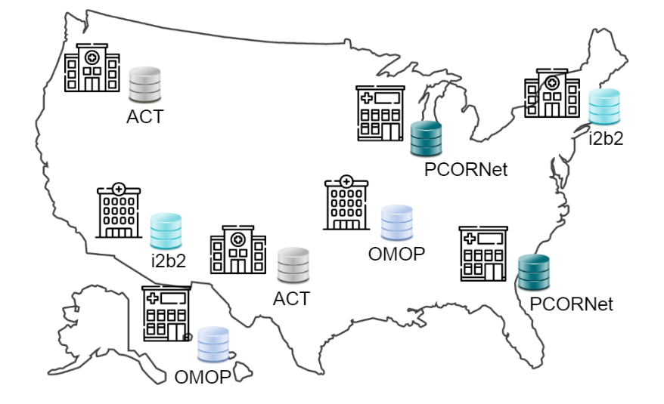
Observational Health Data Limitations: Heterogeneity
Geographic Effects
Clinical Site Features
Electronic Health Record Systems
Clinical Data Models, Vocabularies, and Versions
Clinical Workflows, Care Practices, and Charting
Patient Access to Care, Trust, Transparency, Compliance, and Context
Privacy Preserving Record Linkage (PPRL): Data Augmentation Limited to certain patient populations and sites (i.e. Medicare, Death, Cross-Site Patient Linkage)
Etc………
Relevant N3C Tables: Manifest, OMOP, PPRL Data
Notes:
Some features can be systematically teased out but many of these effects are hidden or too complex to entirely account for. Still we must do our best to at least consider, adjust our analyses when we can, and disclose as much as we are aware of. EXAMPLE: Long COVID. It is critical to work closely with clinicians on your team to think through limitations that are specific to your research question.
QUESTIONS?

Slide 10
Observational Data Limitations: Positive & Unlabeled Data
POSITIVE:
DETECTED/DOCUMENTED/MAPPED/FOUND
NEGATIVE? UNLABELED / UNKNOWN?
SYSTEMATICALLY MISSING?
Notes:
So before we move on to Andrea’s demonstration of how to import and use some of the Logic Liaison templates, I want to talk to you more about important considerations for analysts who are deriving cohorts and variables from any observational health data.
REAL DATA HAS LOTS OF HOLES. MAPPED DATA HAS EVEN MORE HOLES. N3C ACCEPTS DATA AS SENT BY SITES. THERE ARE BASIC QUALITY THRESHOLDS FOR PARTICIPATION, but as we saw on the last slide it still a ton of variability. COVID has become more difficult to study over time. Prevalence of home tests makes COVID index date hard to know. Control patients not all negative. Talk about Long COVID. Informatics Approaches: Data Salvage, Imputation, Computable Phenotyping, Site Filtering, Patient Filtering. Analytic Approaches: Multivariate Analysis, Matching, Hierarchical Modeling, Stratification, etc. Example from session three: undocumented bird attacks vs never happened vs the md doesn’t know there is a code vs occurred in other institution and recorded there.
QUESTIONS?

Slide 11
Observational Health Data: Time-Related Limitations
STROKE
(inpatient)
MD prescribes new antiplatelet
(Primary Care)
2nd STROKE
(inpatient)
12/1/2017
1/15/2021
2/8/2022
6/21/2020
2/3/2022
8/23/2022
COVID+ PCR Test
(outpatient)
COVID+ Antigen Test Results
(at home)
Long COVID
(outpatient note)
BEWARE of DATE SHIFTING, DATA LOSS, UNRELIABLE START/STOP DATES (chronic issues, patient lost to follow-up), EFFECT OF OBSERVATION PERIODS (data collection periods, data freshness), PHENOTYPE (patient selection effects)
Relevant N3C Tables: Manifest, OMOP, PPRL Data
Notes:
Date shifting in level 2 and some level 3. Be careful in case of needing real calendar dates (for example, pandemic phases).
CLICK: Events that were recorded prior to our observational dataset start date will be unknown to us.
CLICK: Meds may be prescribed but do we know if they are they actually taken? If so, for how long? The initial prescribing of this med may not be captured until much later.
CLICK: Some events occur that never go into a medical record.
CLICK: When does a chronic issue really start? For example, a patient’s diabetes may have started in 2010, but not be captured in our dataset until recorded at the time of the second stroke. What about data freshness?
OTHER: Does the dataset phenotype have an effect (i.e. COVID enclave has matched controls, tenant phenotype requires two yrs survival)? The enclave phenotype becomes part of inclusion criteria for all studies done on the data.
NOTE THAT controlled studies have inclusion bias that we partially with avoid observational research
QUESTIONS

Slide 12
Community Tools

Slide 13
Eliminating Redundant Efforts: Data and Logic Liaison Tools
Apply additional logic
Provide code templates that accelerate the generation of derived data elements
 | v1 | v2 | … | vX
Patient 1 | 0 | 0 | … | 1
Patient 2 | 0 | 1 | … | 0
… | … | … | … | …
Patient n - 1 | 0 | 1 | … | 0
Patient n | 1 | 0 | … | 1
Values
Categorical
Binary Flags
3
Apply Concept Sets
Generate and maintain a reliable core library of concept sets
2
Filtered, labeled data
Source Data
Augment source OMOP tables with additional pre-processing
1
Raw noisy data
Notes:
As we began working in N3C in 2020, we realized that there were common derived data elements that continually surfaced in many COVID analyses. These included things like confirmed COVID positivity, patient visit severity at the time of first known COVID, common comorbidities or conditions that the CDC was learning were associated with more severe COVID, etc. Two core service teams emerged and worked closely together to provide tools that would eliminate much of the redundant work being done across research studies.

Slide 14
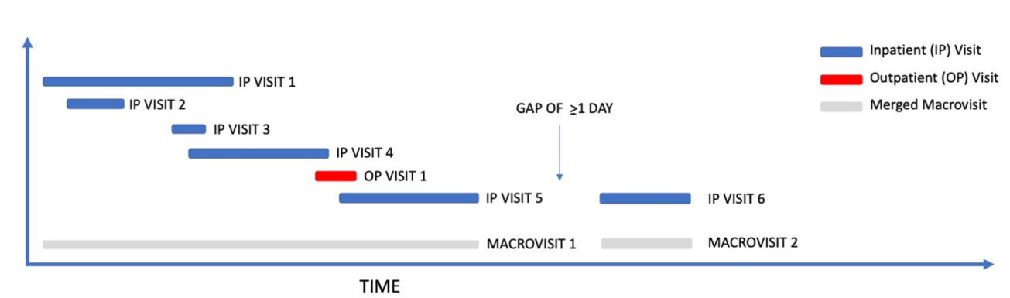
Data Cleaning: N3C Macrovisits
Clinical encounter heterogeneity and methods for resolving in networked EHR data: A study from N3C and RECOVER programs. Peter Leese, Adit Anand, Andrew Girvin, Amin Manna, Saaya Patel, Yun Jae Yoo, Rachel Wong, Melissa Haendel, Christopher G Chute, Tellen Bennett, Janos Hajagos, Emily Pfaff, Richard MoffittmedRxiv 2022.10.14.22281106; doi: https://doi.org/10.1101/2022.10.14.22281106
N3C Microvisit to Macrovisit Map Table:
macrovisit_id, macrovisit_start_date, macrovisit_end_date
Notes:
(also mentioned in session 1 and 2). The Microvisit to Macrovisit Map table is an augmented version of the visit_occurrence OMOP table. Macrovisit_id, macrovisit_start_date, macrovisit_end_date

Slide 15
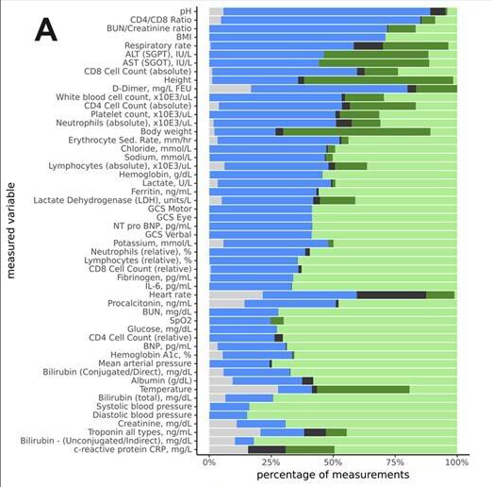
Data Cleaning: N3C Measurement Harmonization
 | Harmonized Unit Present in Source
 | Unit Mapped and Value Converted
 | Unit Absent but Inferred and Converted
 | Unit Missing (Unable to infer)
 | Unit Mapped to Null (Nonsensical Value)
Bradwell KR, Wooldridge JT, Amor B, et al. Harmonizing units and values of quantitative data elements in a very large nationally pooled electronic health record (EHR) dataset. J Am Med Inform Assoc. 2022;29(7):1172-1182. doi:10.1093/jamia/ocac054
N3C Measurement Dataset Fields: harmonized_unit_concept_id, harmonized_value_as_number
Notes:
(also mentioned in session 1) Note that special columns have been added to the N3C measurement tables reflecting this work

Slide 16
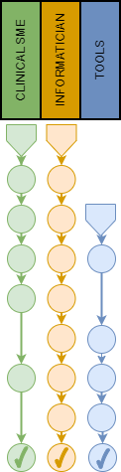
N3C Recommended Concept Sets
1. Assemble Team: N3C Clinical Domain Team Leads (or delegates), N3C Data or Logic Liaison (informaticians and analysts)
2. Articulate Goals: Define the scope, intentions, and limitations
3. Explore: Use OHDSI tools to explore the CDM and identify candidate codes
4. Compare: Use both authoritative and community-built concept sets
5. Review: Present to a broader team of clinical experts
6. Collapse: Reduce the intensional concept set expression as parsimonious as possible, retaining all the approved concepts collected in prior steps.
7. Document: Intention, Limitations, Provenance, and expert Reviews
8. Present: Present for final vetting at the Data Liaison informaticists’ meeting.
9. Publish: Marked as N3C Recommended and published to Zenodo
Notes:
In addition to building these templates, we worked with the Data Liaison team to develop a core set of robust concept sets that are used as building blocks for our default features. This slide shows the process by which these are created. As Shawn mentioned, you can filter the N3C concept set browser to find these and they are also published to Zendodo.

Slide 17
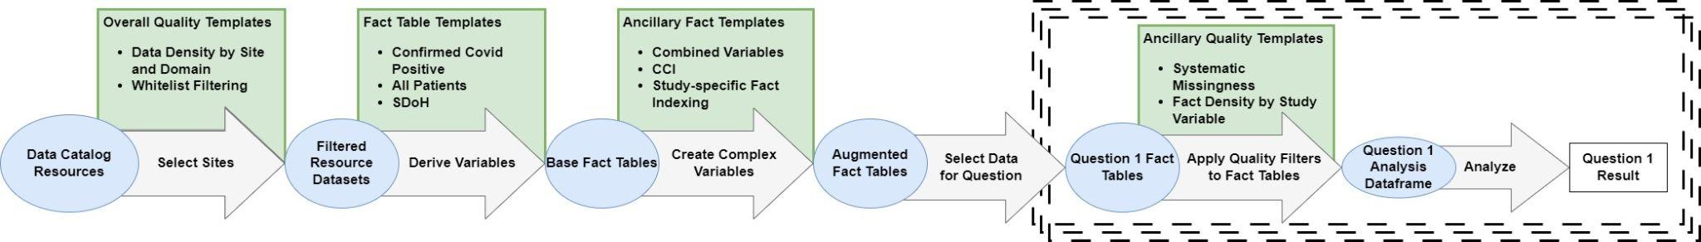
Eliminating Redundant Work: Logic Liaison Templates
Notes:
Logic Liaisons build and maintain code templates that help you rapidly (do each step here). They not only produce hundreds of derived variables and related quality assessments, they also support easy customization for quick adaptation to a specific research problem. These templates have now been used hundreds of times by N3C analysts. Note that the templates leverage N3C recommended csets, macrovisits as well as harmonized measurements.

Slide 18

Logic Liaison Tables: Minimal Data Cleaning/Imputation
BMI/Obesity:
Unreasonable height/weight/BMI thresholds are applied and can be configured by the user
BMI computed when not reported and obesity imputed using BMI>30
Unreasonable date detection:
DOB
Visits
Death
N3C Logic Liaison Derived Fact Tables: COVID+, All Patients, Clinical Tenant

Slide 19
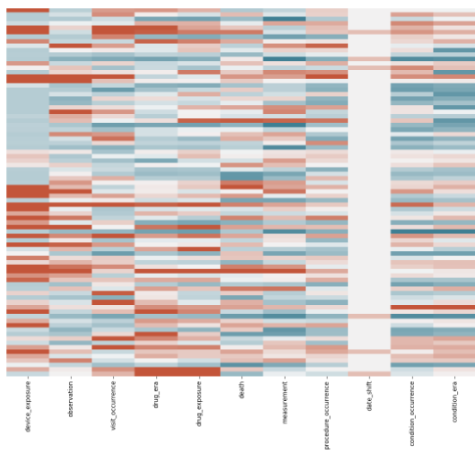
Logic Liaison Quality Templates:
Domain Density and Data Partner “Whitelist Filtering”
How rich is each site’s data by OMOP Domain?
Which sites meet customizable data quality standards
N3C Logic Liaison Quality Templates: Domain Density, Whitelist Filtering
Notes:
The whitelist template creates a bar plot showing whitelisted data partners that have, at minimum, a certain percentage of COVID patients associated with a specified measurement, condition, drug, procedure, etc. A table showing "Whitelisted sites" is also generated, which filters out some data partners, either for not meeting the minimum percentage or for having more than 10% of their patients with a covid hospitalization that starts more than 200 days before their covid index date. Data partners will also be filtered out based on the maximum number a days a date can be randomly shifted, which is determined by the user.

Slide 20

Logic Liaison Quality Templates:
Fact Density and Systemic Missingness
Quality must be assessed again AFTER creating your derived variables and PRIOR to analysis
N3C Logic Liaison Quality Templates: Fact Density by Site Visualization

Slide 21







Key Takeaways
Work with a breadth of domain experts
Don’t recreate the wheel
Interrogate your raw data and derived dataframes
Leverage metadata
Understand and disclose limitations
Carefully derive features
Test your assumptions
Patience and humility
Notes:
Work with a breadth of domain experts: clinicians, patient advocates, informaticians, and analysts
Don’t recreate the wheel (search literature, use shared code, etc.)
Interrogate your raw data and derived dataframes
Leverage metadata (i.e. “Manifest” table in N3C, data release notes, etc.)
Understand and disclose limitations
Strive for meaningfulness when creating derived data elements - do code reviews!
Always test your assumptions
Patience and humility are your friends

